Slide 1
CHAPTER 4
Number Theory and Cryptography
4.1 Divisibility and Modular Arithmetic可分割性和模块化算术
4.3 Primes and Greatest Common Divisors素数和最大公除数
4.4 Solving Congruences解决共轭的问题
1
Notes:
4.2 基数不要求
唯一做要求的是（整除，模运算，最大公倍数，公约数）

Slide 2
2. Division
【Definition】When a divides b we say that a is a factor (divisor)除数of b and that b is a multiple倍数of a.
Notations:
---- a 整除 b
---- a 不能整除 b.

Slide 3
基本性质

Slide 4
3. The Division Algorithm
【Theorem 2】Let a be an integer and d a positive integer.
Then there are unique integers q and r, with 0≤r<d such that
a = dq + r.
Note: d is the divisor除数
a is the dividend被除数
q is the quotient商
r is the remainder 余数(正)
〖Example 2〗 What are the quotient and remainder when −11 is divided by 3?
Solution:
−11 = 3 ⋅ (−4) + 1
− 11 div 3 = −4 and − 11 mod 3 = 1

Slide 5
4. Congruence Relation同余
Notation: a≡b(mod m)
Note: m is the modulus of the congruence a≡b(mod m)
【Theorem 4】Let m be a positive integer.
a ≡ b (mod m) iff there is an integer k
such that a = b + km.
【Theorem 5】Let m be a positive integer.
If a ≡ b (mod m) and c ≡ d (mod m),
then a + c ≡ b + d (mod m)
ac ≡ bd (mod m)

Slide 6
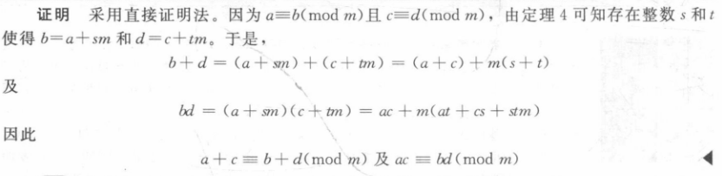

Slide 7
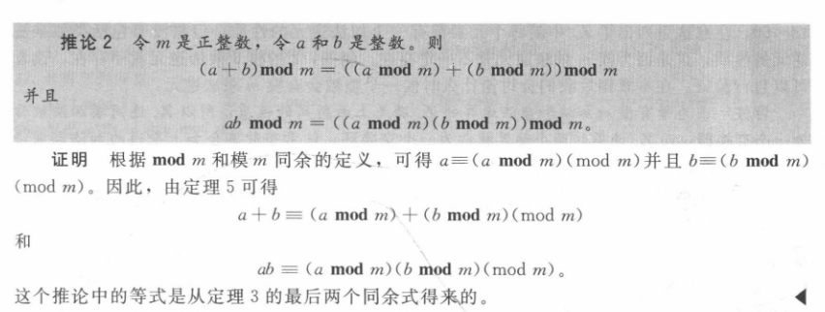
运算技巧

Slide 8
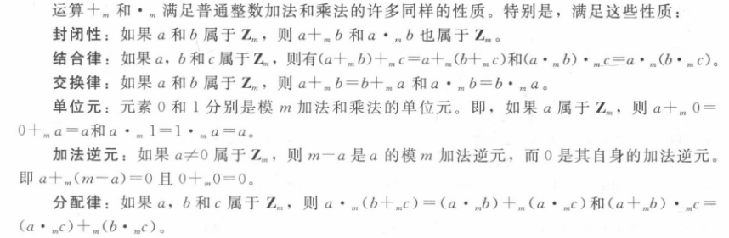
模算术
【Definition】Zm 为小于m的非负整数 {0, 1, …., m−1}, we can define two operations on Zm:
addition modulo m +_{m}
a +_{m} b = (a + b) mod m.
multiplication modulo m ∙_{m}
a ∙_{m} b = (a ∙ b) mod m.

Slide 9
Primes 素数
【Definition 1】A positive integer p greater than 1 is called prime if the only positive factors of p are 1 and p.
A positive integer that is greater than 1 and is not prime is called composite 合数.
埃拉托色尼筛法The sieve of Eratosthenes可以用来找出所有不超过整数 n 的素数。

Slide 10
【Theorem 1】算术基本定理
每个大于1的整数都可以唯一地写为两个或多个素数的
乘积，其中素数因子以非递减序排列
【Theorem 2】如果n是一个合数composite integer, 那么n必有一个
素因子小于等于
Proof:
If n is composite, it must has a factor a with 1<a<n.
Hence n=ab.
We see that 1<a< or 1<b< , otherwise, ab>n.
Hence , n has a positive divisor not exceeding .
This divisor is either prime or, by the fundamental Theorem of Arithmetic, has a prime divisor.
In either case, n has a prime divisor less than or equal to .

Slide 11
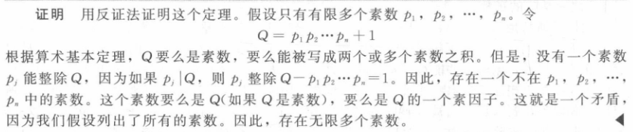
【Theorem 3】素数有无穷多
For example,
Show that 113 is prime.
Solution:
The primes not exceeding are 2,3,5,7.
Since 113 is not divisible by 2,3,5,or 7, it follows that 113 is prime.

Slide 12
Problem:
How to find the prime factorization of a positive integer n?
Begin by dividing n by successive primes, starting with the smallest prime 2.
If no prime factor not exceeding is found, then n is prime, otherwise, if a prime factor p is found, continue by factoring n/p. Note that n/p has no prime factors less than p.
Again by dividing n/p by successive primes, starting with the prime p.
This procedure is continued until the factorization has been reduced to a prime.

Slide 13
Mersenne primes梅森素数
Form: 2^{p}-1, where p is also prime
For example,
2²-1=3, 2³-1=7,2⁵-1=31 are Mersenne primes,
while 2¹¹-1=2047 is not a Mersenne prime.

Slide 14
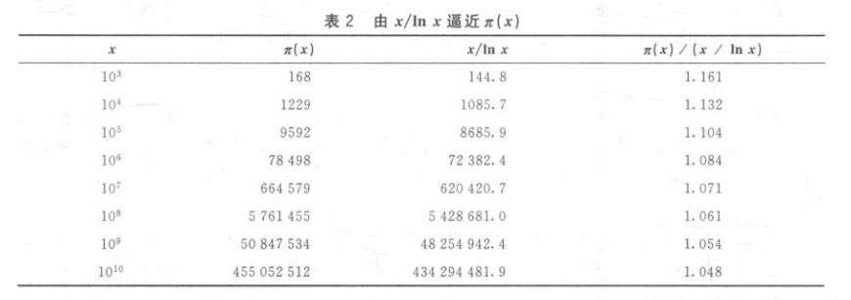
The distribution of primes
【Theorem 4】THE PRIME NUMBER THEOREM
当x无限增长时，不超过x的素数个数Π(x)与 x/ln x之比趋近于1

Slide 15
2. Greatest common divisor and least common multiple
【Definition 2】Let a and b be integers, not both zero. The largest integer d such that d∣a and d∣b is called the greatest common divisor最大公约数 of a and b .
Notation: gcd(a, b)
【Definition 3】最大公约数为1，则互素 relatively prime
【Definition 4】The integers a₁,a₂,…a_{n} are pairwise relatively prime if gcd(a_{i}, a_{j})=1 whenever 1≦i<j ≦n.

Slide 16
Problem: How to find gcd(a,b) ?
gcd(a,b) can be computed using the prime factorizations of a and b.
a = p₁^{a1} p₂^{a2} … p_{n}^{an}
b = p₁^{b1} p₂^{b2} … p_{n}^{bn}
gcd(a,b) = p₁^{min(a1,b1)} p₂^{min(a2,b2)} … p_{n}^{min(an,bn)}
〖Example 3〗 Find gcd(120,500).
Solution:
120 = 2³ ⋅ 3 ⋅ 5 = 2³ ⋅ 3¹ ⋅ 5¹
500 = 2² ⋅ 5³ = 2² ⋅ 3⁰ ⋅ 5³
gcd(120,500) = 2^{min(3,2)} ⋅ 3^{min(1,0)} ⋅ 5^{min(1,3)}
= 2² ⋅ 3⁰ ⋅ 5¹
= 20

Slide 17
【Definition 5】The least common multiple最小公倍数 of the positive integer a and b is the smallest integer that is divisible by both a and b.
Notation: lcm(a, b)
Problem: How to find lcm(a,b) ?
Suppose that the prime factorizations of a and b are as follows.
a = p₁^{a1} p₂^{a2} … p_{n}^{an}
b = p₁^{b1} p₂^{b2} … p_{n}^{bn}
lcm(a,b) = p₁^{max(a1,b1)} p₂^{max(a2,b2)} … p_{n}^{max(an,bn)}

Slide 18
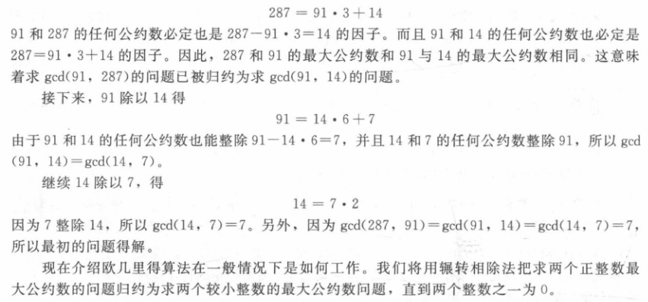
【Theorem 5】Let a and b be positive integers, Then
ab = gcd(a,b) ×lcm(a,b)

Slide 19
2. The Euclidean Algorithm欧几里德算法
【LEMMA 1】 Let a = bq + r, where a,b,q,r are integers.
Then gcd(a,b) = gcd(b,r).
Proof:
Show that the common divisors of a and b are the same as the common divisors of b and r.

Slide 20
Suppose that a and b are positive integers with a≥b.
Let r₀=a and r₁=b.
r₀ = r₁q₁ + r₂ 0≤r₂＜r₁,
r₁ = r₂q₂ + r₃ 0≤r₃＜r₂,
……
r_{n-2} = r_{n-1}q_{n-1} + r_{n} 0≤r_{n-1}＜r_{n,}
r_{n-1} = r_{n}q_{n .}
It follows from Lemma 1 that
gcd(a,b) = gcd(r₀ , r₁ ) = gcd(r₁ , r₂ )
= …… = gcd(r_{n-2} , r_{n-1} ) = gcd(r_{n-1} , r_{n} )
= gcd(r_{n} , 0 ) = r_{n}

Slide 21
ALGORITHM The Euclidean Algorithm.
Procedure gcd (a,b: 正整数)
x:=a
y:=b
while y≠0
begin
r:=x mod y
x:=y
y:=r
end {gcd(a,b) is x}

Slide 22
2. gcds as Linear Combinations gcd线性组合
【Bézout’s Theorem】贝组定理 Let a and b be positive integers, then
there exist integers s and t such that gcd(a,b) = sa + tb,
Note:
s and t : Bézout coefficients of a and b.
For example, gcd(6,14) = (−2)∙6 + 1∙14

Slide 23
For example, 这个方法叫做扩展欧几里得算法
express gcd(252,198) = 18 as a linear combination of 252 and 198.
Solution:反向
First use the Euclidean algorithm to show gcd(252,198) = 18
252 = 1∙198 + 54
198 = 3 ∙54 + 36
54 = 1 ∙36 + 18
36 = 2 ∙18
Now working backwards, from Ⅲ and Ⅱ above
18 = 54 − 1 ∙36
36 = 198 − 3 ∙54
Substituting the 2nd equation into the 1st yields:
18 = 54 − 1 ∙(198 − 3 ∙54 )= 4 ∙54 − 1 ∙198
Substituting 54 = 252 − 1 ∙198 (from Ⅰ)) yields:
18 = 4 ∙(252 − 1 ∙198) − 1 ∙198 = 4 ∙252 − 5 ∙198

Slide 24
3. Dividing Congruences by an Integer
【Theorem】Let m be a positive integer and let a, b, and c be integers.
If ac ≡ bc (mod m) and gcd(c,m) = 1, then a ≡ b (mod m).

Slide 25
Linear Congruences
【Definition】A congruence of the form ax ≡ b( mod m),
where m is a positive integer, a and b are integers, and x is a variable, is called
a linear congruence线性同余方程
【Definition】An integer ā such that āa ≡ 1( mod m) is said to be an inverse逆 of a modulo m.（可以证明存在且唯一）
Example:
5 is an inverse of 3 modulo 7 since 5∙3 = 15 ≡ 1(mod 7)

Slide 26
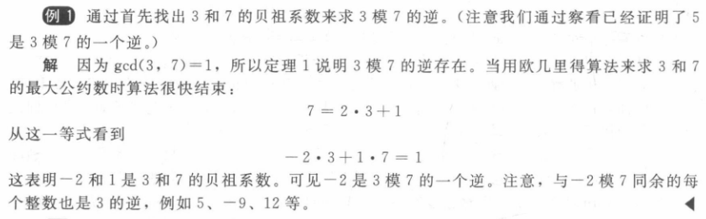

Slide 27
Example: Find an inverse of 101 modulo 4620.
Solution:
First use the Euclidian algorithm to show that gcd(101,4620) = 1.
4620 = 45∙101 + 75
101 = 1∙75 + 26
75 = 2∙26 + 23
26 = 1∙23 + 3
23 = 7∙3 + 2
3 = 1∙2 + 1
2 = 2∙1
Working Backwards:
1 = 3 − 1∙2
1 = 3 − 1∙(23 − 7∙3) = − 1 ∙23 + 8∙3
1 = −1∙23 + 8∙(26 − 1∙23) = 8∙26 − 9 ∙23
1 = 8∙26 − 9 ∙(75 − 2∙26 )= 26∙26 − 9 ∙75
1 = 26∙(101 − 1∙75) − 9 ∙75
= 26∙101 − 35 ∙75
1 = 26∙101 − 35 ∙(4620 − 45∙101)
= − 35 ∙4620 + 1601∙101
Since the last nonzero remainder is 1, gcd(101,4620) = 1
Bézout coefficients :
− 35 and 1601
1601 is an inverse of 101 modulo 4620

Slide 28
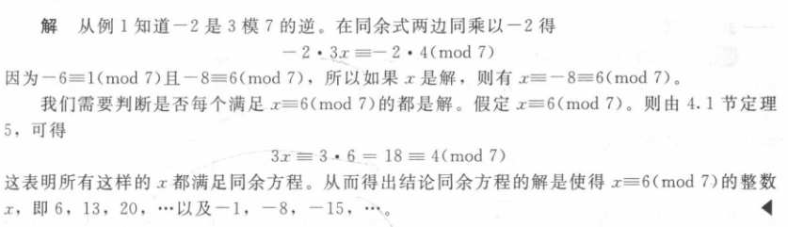
Using Inverses to Solve Congruences
6 + 7k

Slide 29
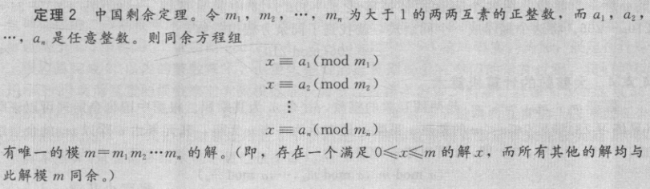
The Chinese Remainder Theorem 中国剩余定理

Slide 30
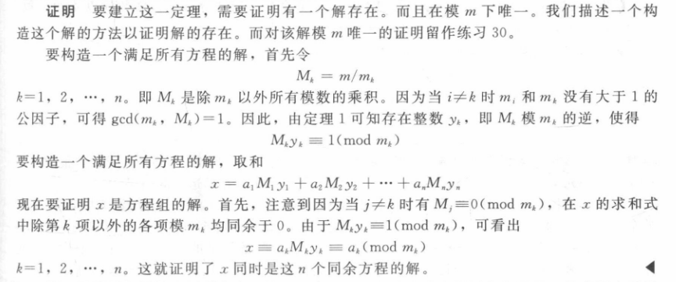
The Chinese Remainder Theorem

Slide 31
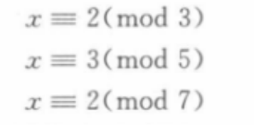
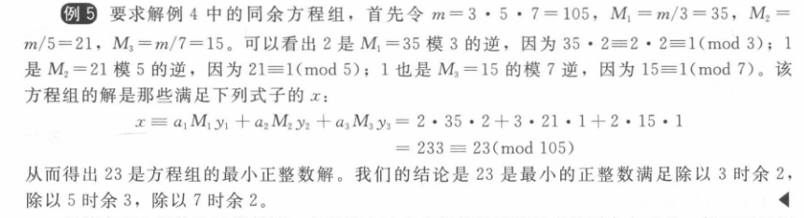
The Chinese Remainder Theorem
但是后面的反向替换法会更方便一些

Slide 32
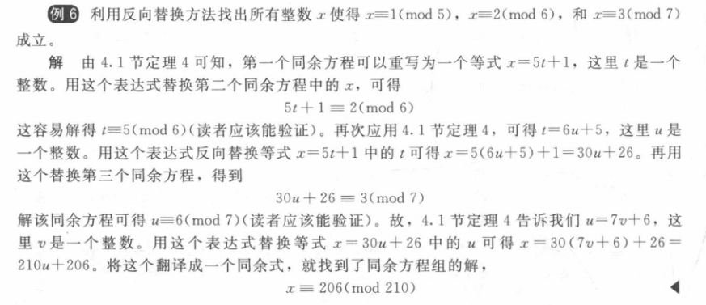
Back Substitution 反向替换法

Slide 33
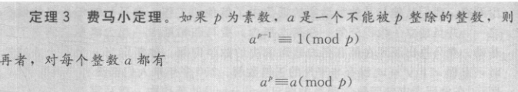
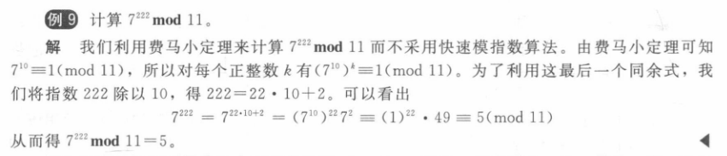
2023必考，重点掌握

